Slide 1
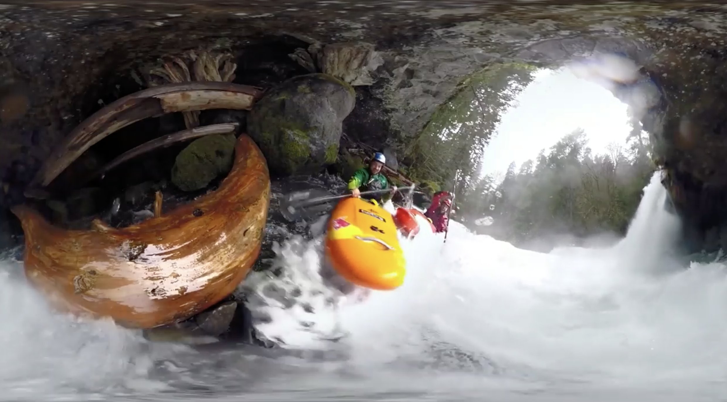
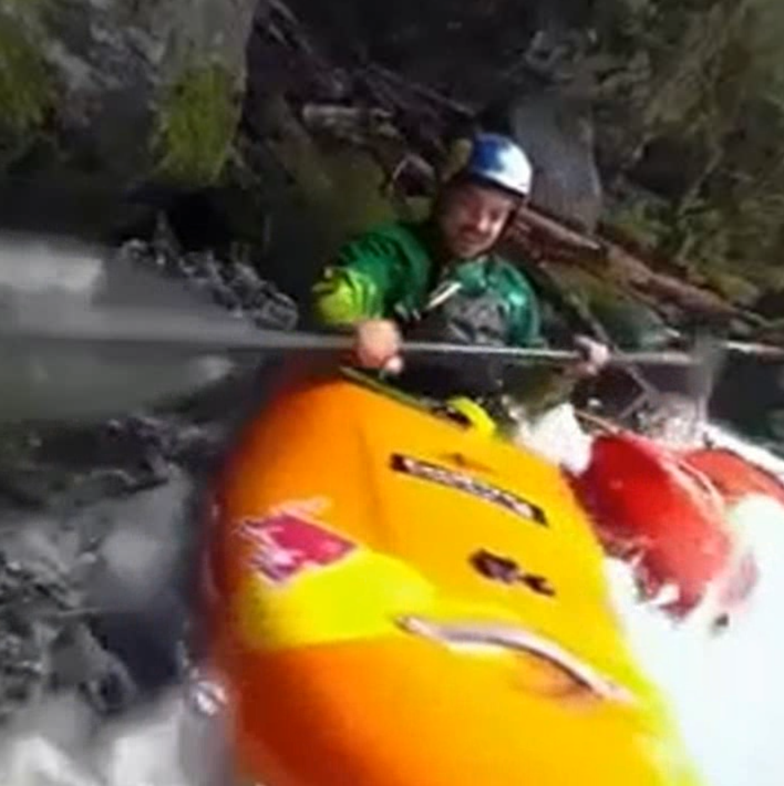
Smart 360 Pilot
Automatic 360° Video Cinematography
Jaskaran Singh 102083046
Kartik Mathur 101903394
Aniket Kumar 101903608
Aryan Bansal 101903590

Slide 2
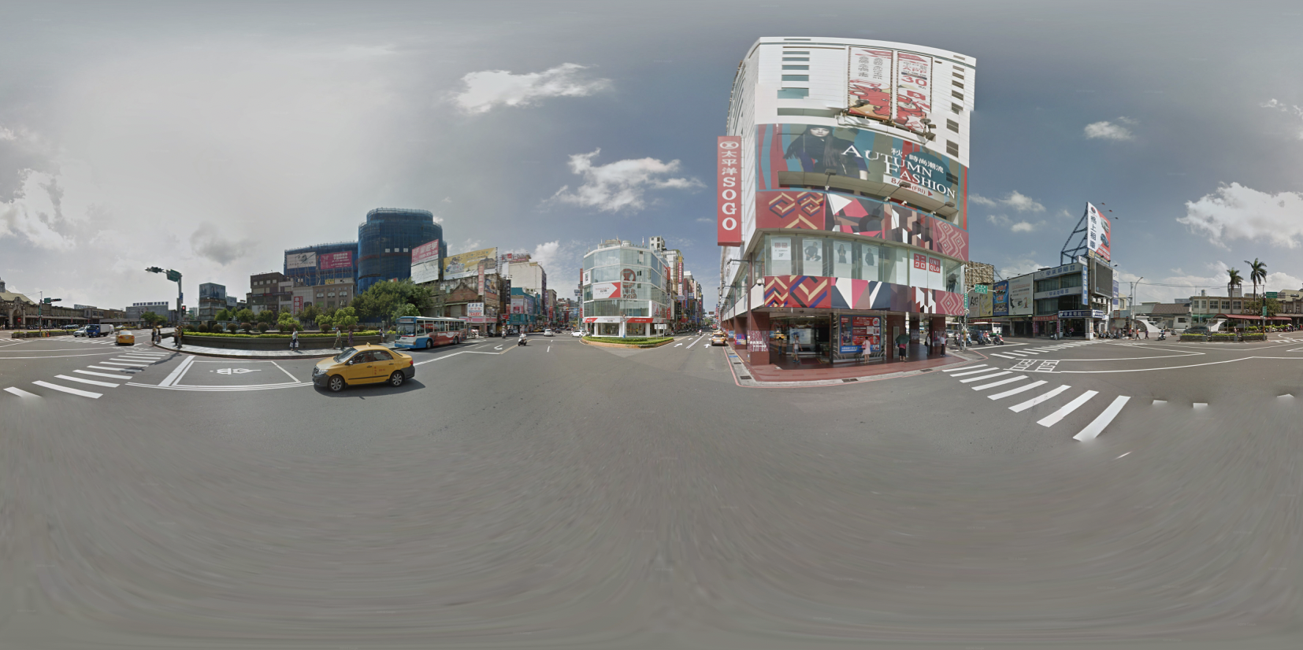
360° videos are becoming very popular nowadays.
They allow for an immersive three-dimensional experience
Multimedia technology advancements have made them easily available.

Slide 3
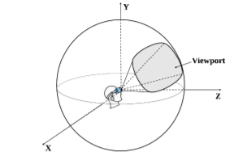
Their Limitations:
Require special equipment like VR Headset
Require sensors like Gyroscope, Accelerometer.
User needs to constantly adjust head position to follow area of interest in most videos.

Slide 4
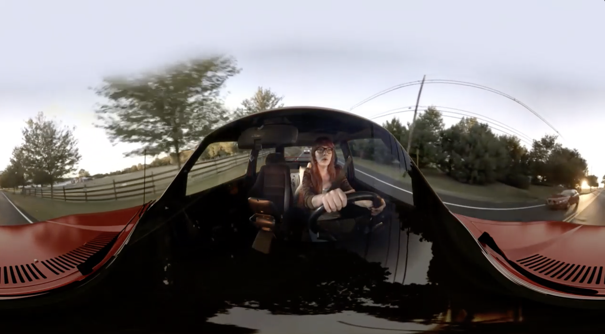
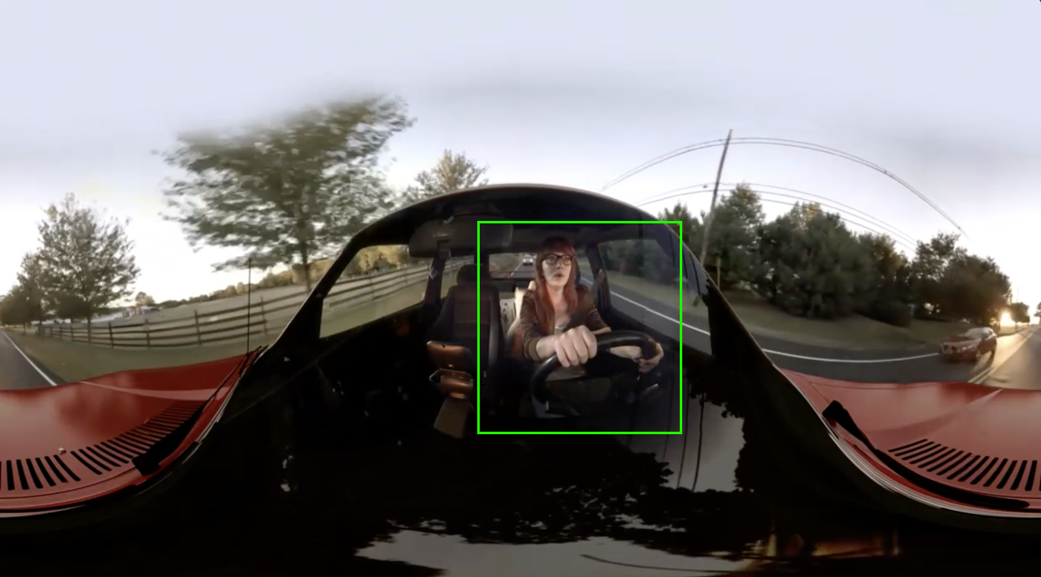
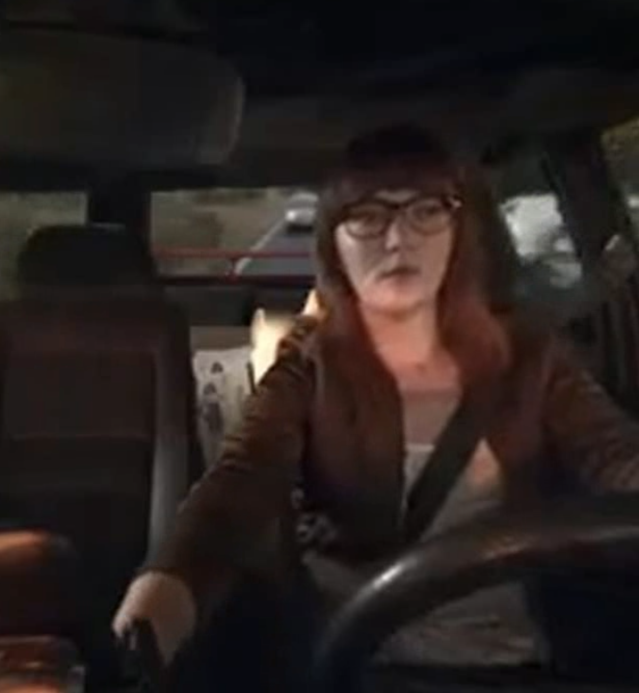
About the project
Takes 360° panoramic video as input
Automatically identifies key area-of-interest (Acts like pilot)
De-warps the equirectangular view around that area. (Cinematography)
Produces regular-looking 2D video of key area
An equirectangular video frame (360 panoramic)
Recognizing Key area of interest
Map and flatten onto 2D space

Slide 5
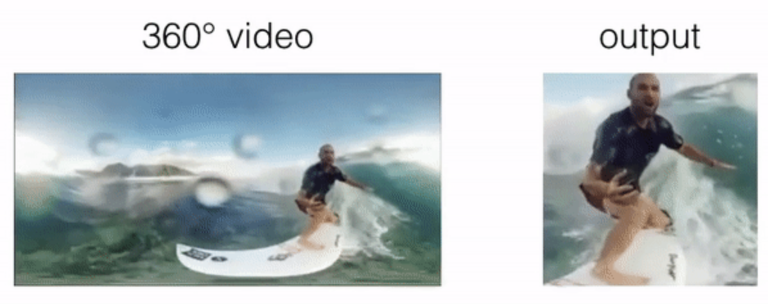
Existing work : Deep 360 Pilot
Uses deep learning to perform same task for sports videos
Limitations:
Needs special NVIDIA GPU with CUDA Cores
Only works on Linux
Computation intensive
Needs datasets which are hardly available.

Slide 6
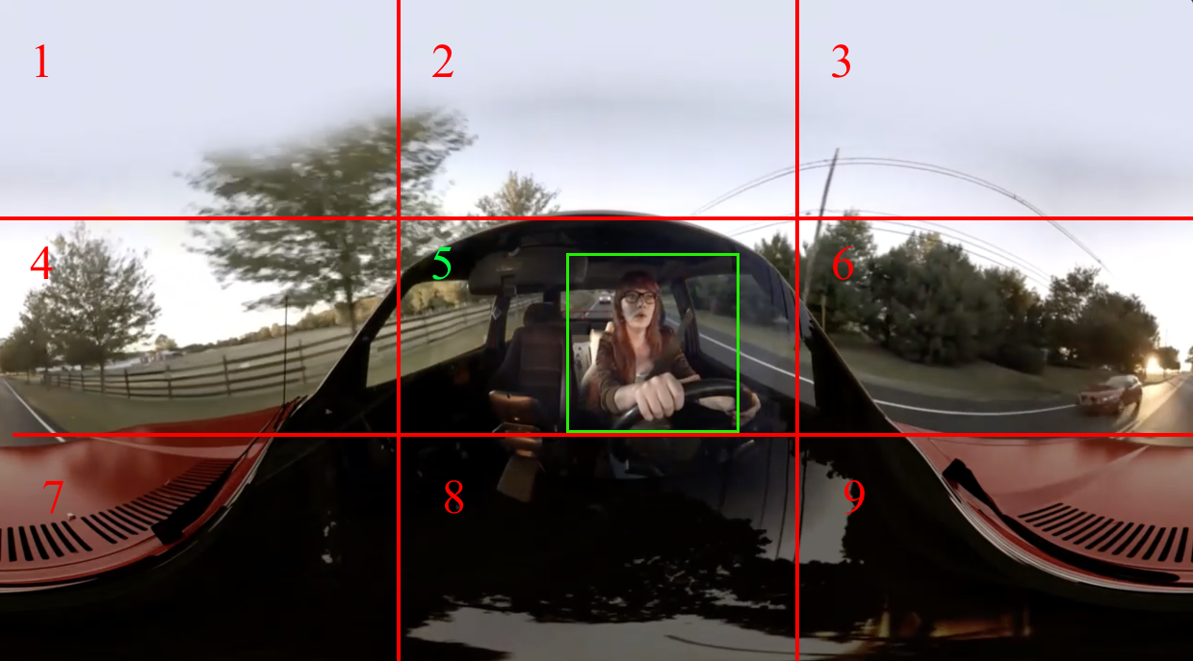
Our Implementation
Step 1:
Split video into frames
Step 2:
Divide video frame into ’n’ portions. Eg: 3
We have 360°/3 = 120° subsets.
Apply detection filter like HaarCascade to find x,y position of area of interest.
Divide frame width and height into ’n’ portions again, Eg: video width is 300 pixels, 3 subsets of 100 pixels are formed.
Now find out what subset of latitude and longitude video is in.
1

Slide 7
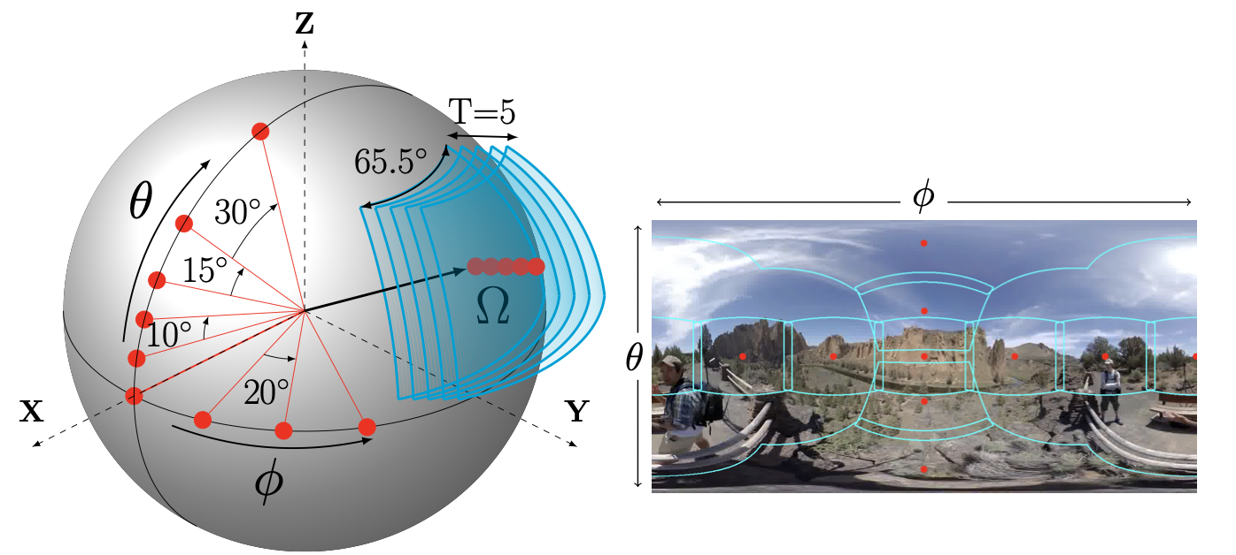
Step 3:
Step 4:
A function to de-warp the equirectangular view based on section of video is applied to frame (eg: the key section was No.5 in last page)
The function is of this form :
equ.GetPerspective(60, 0, 0, 720, 1080) parameters(FOV, theta, phi, height, width)
Same steps 1-3 are applied every 8th frame (for performance) and resulting image frames are recompiled into a video.
3. The function will use values φ and θ according to the section to produce a perspective image from the equirectangular image. Eg: for section 5, phi = 0 and theta = 0
1

Slide 8
Novelty from our side
100 % original implementation by us.
No code from Deep360Pilot project was used.
40+ hours of work by every member.
Our implementation DOES NOT require GPU
Yet, runs in reasonable time, because of smart and practical methods used.
Does not require linux, runs on any OS
Fast and simple, yet works with good accuracy
This is because, practically, in almost all 360° videos, the key area rarely changes inside the video
We run the detection filter after 8 frames (3 times/second)
In future, we can use Yolo or other detection algos to improve our code

Slide 9
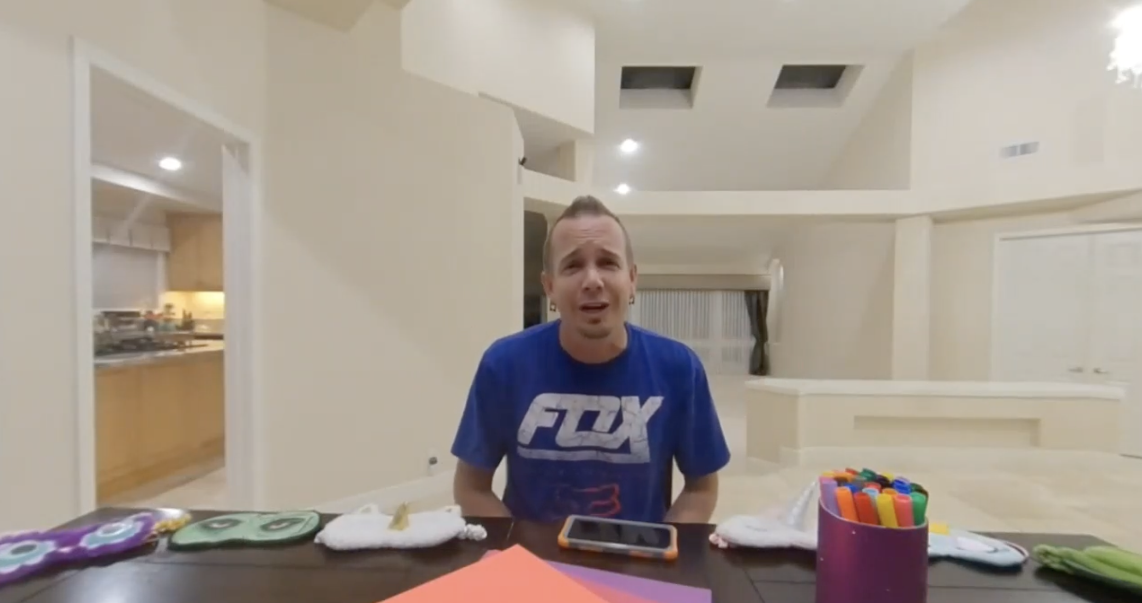
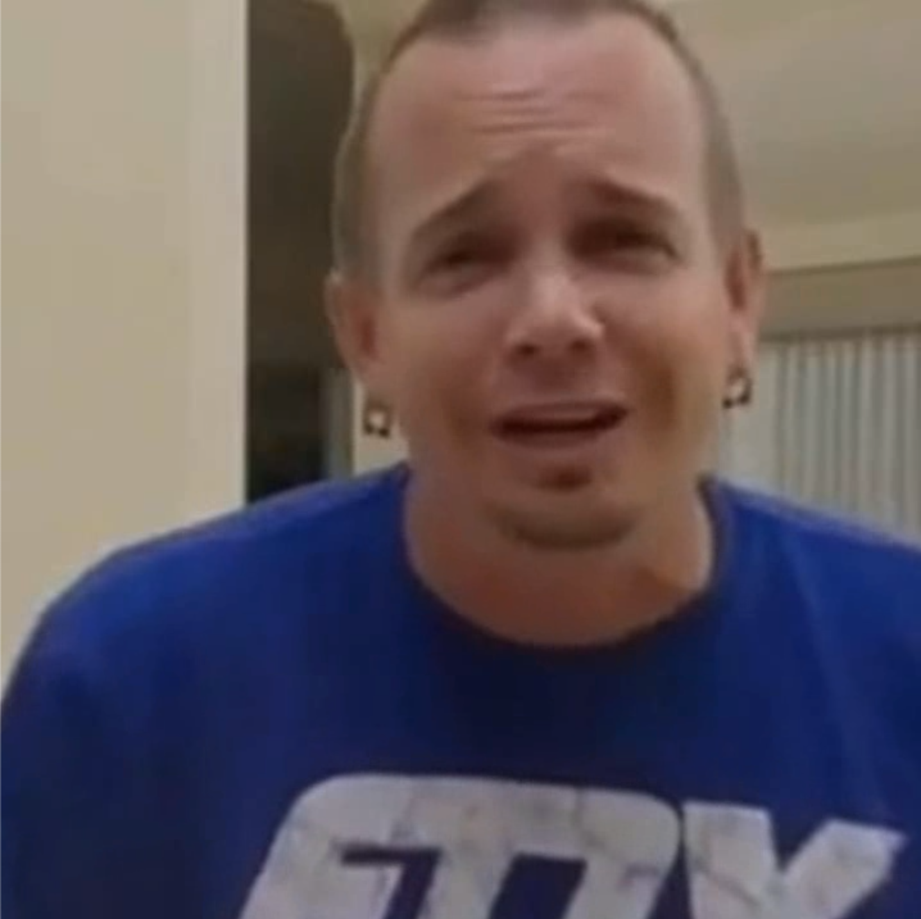
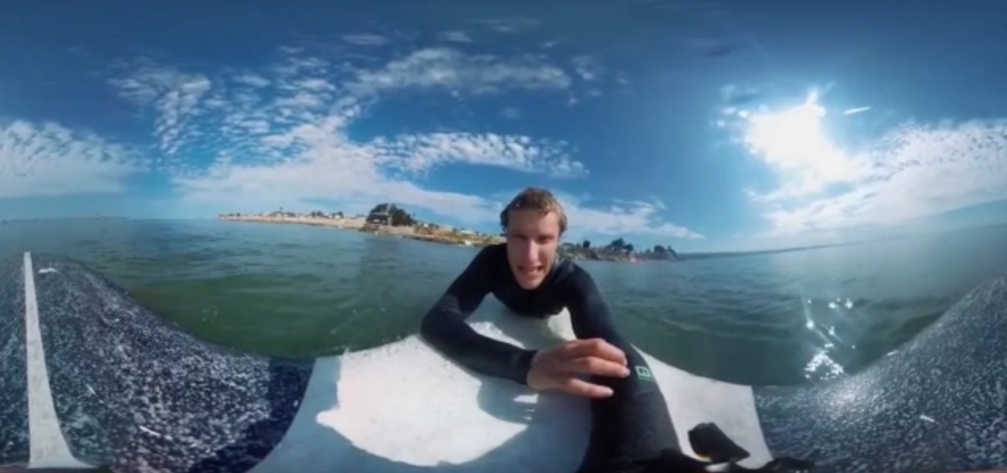
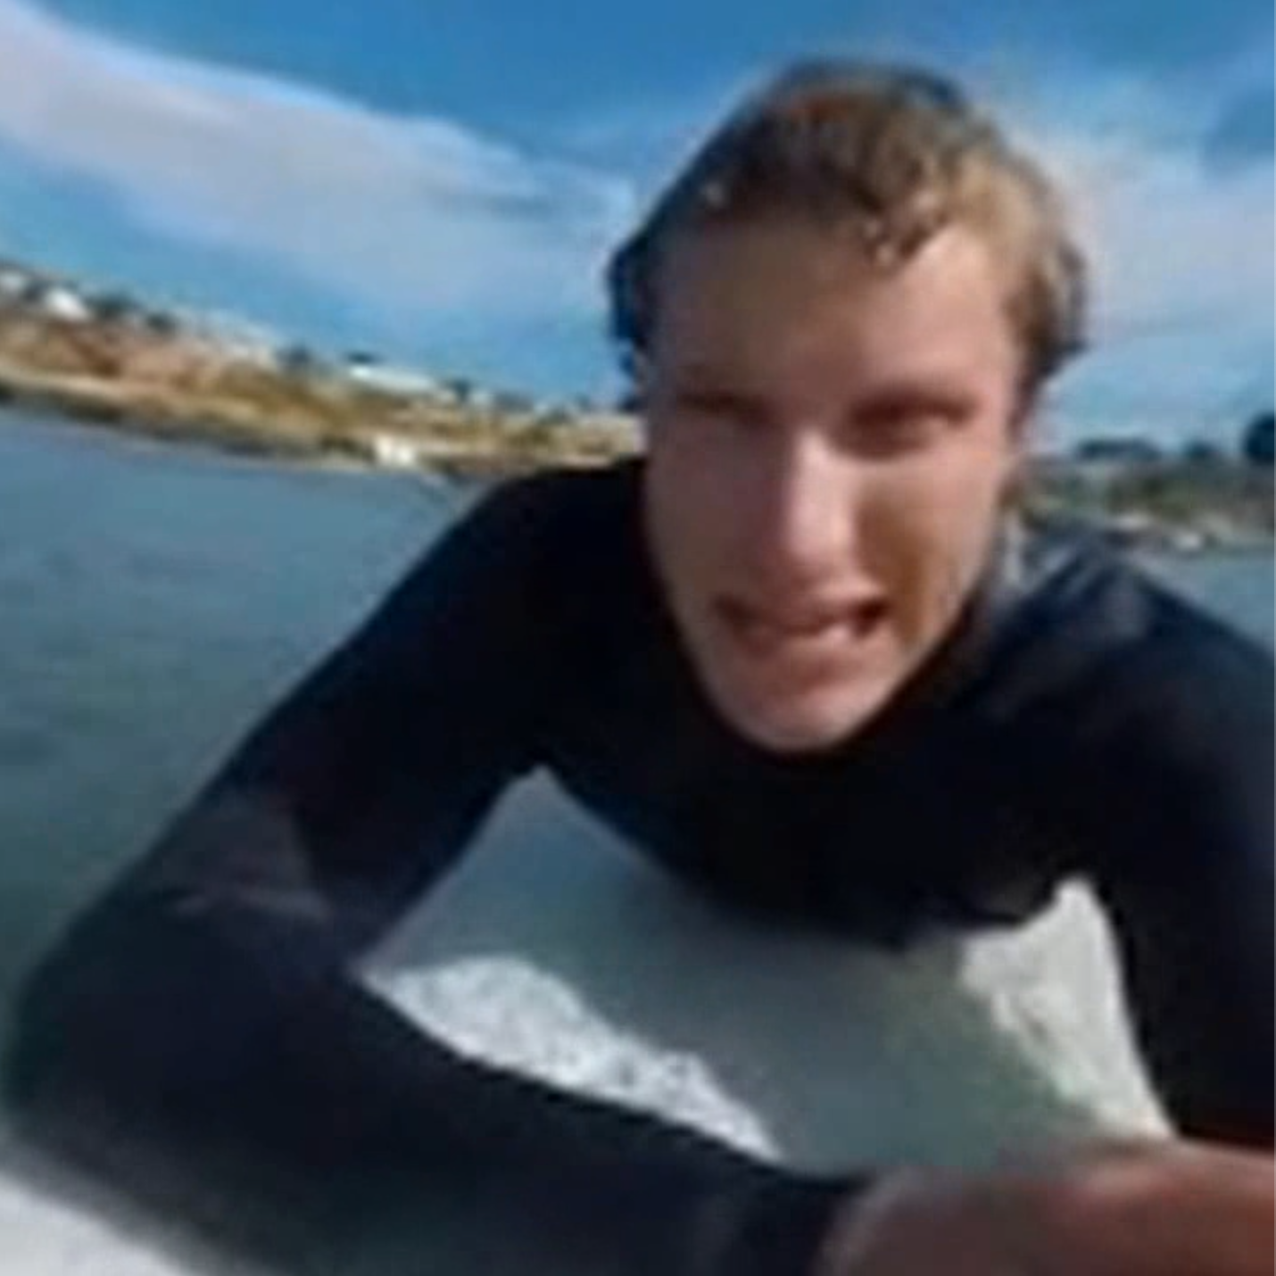
Some Results:
Inputs and outputs are ofcourse videos, these are just snapshots from them for demonstration

Slide 10
Results Breakdown:
True Positive (TP): the number of times correctly predicted key area;
False Positive (FP): the number of times incorrectly predicted key area;
False Negative (FN): the number of times no key area was predicted.
Input Video
 | TP | FP | FN | Correctness | Completeness | Quality
Indoor Video | 3 | 1 | 0 | 75% | 100% | 75%
Outdoor Videos | 5 | 1 | 1 | 83.33% | 83.33% | 71.4%

